Slide 1
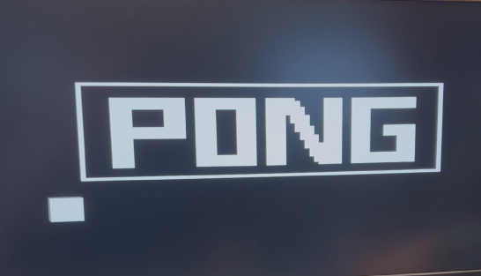
Bringing the Analog World to Digital Design
Team Members:
Conor Naughton
Bin Xu
Yimin Xu

Slide 2
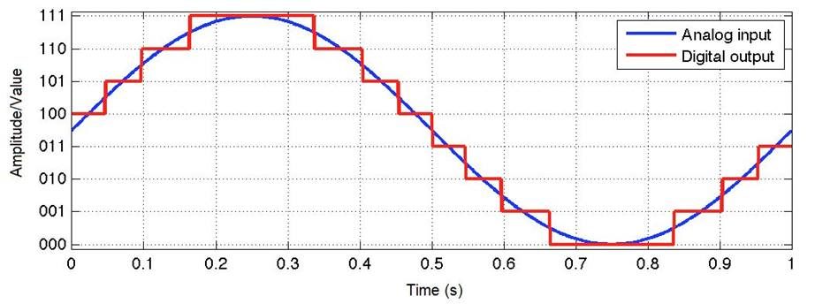
Goals
Explore the use of analog signals
Deep dive into how Analog to Digital Converters (ADCs) work
Motivation
FPGAs work with digital signals however the tasks they are used for often involves analog inputs
Requires interacting with and controlling another component of the development board

Slide 3
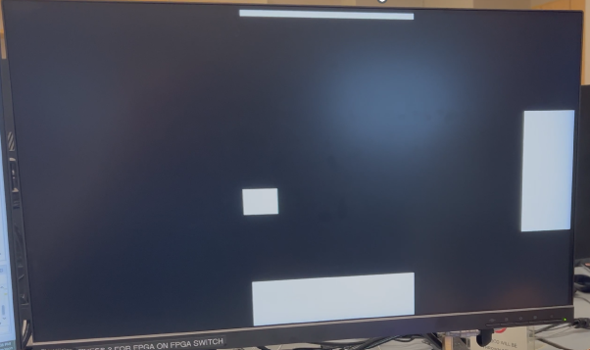
Game Description
Two player Pong
Player 1: Paddle on right edge of screen controlled via board buttons
Moves a discrete amount with each button press
Demonstrates digital input
Player 2: Paddle on bottom edge of screen controlled via analog controller
Moves a variable amount based on analog controller value
Demonstrates analog input
Gameplay
Ball starts moving slowly in random direction
Players move paddles to prevent ball from hitting the edge of the screen
Score increases every time the ball hits the paddle
Ball also moves faster each time it hits a paddle
After achieving a certain score, a second ball is inserted into the game
Once the ball does hit the edge of the screen, a “game over” screen appears
After game is lost, user can display the configuration of paddles and ball when they lost by flipping a switch

Slide 4
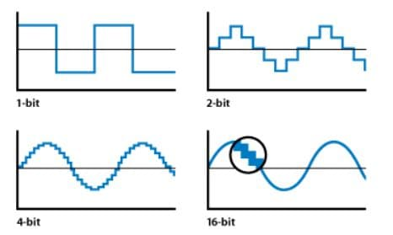
Analog to Digital Converter (ADC)
What is an ADC?
HW that takes in an analog signal and converts it to a digital output
In other words, it changes an analog signal that is continuous in terms of both time and amplitude to a digital signal that is discrete in terms of both time and amplitude
How does an ADC work?
Analog input is sampled at a certain frequency
Sample is quantized into a digital value by comparing with a reference voltage
12-bit ADC => 4096 quantization levels
How does ADC sampling work?
Choose sample rate so the digital output accurately reflects the input (≥ 2x the fastest input frequency)
Max sample rate 1MSPS
Illustration of analog input being approximated by a digital output
Illustration of quantization levels

Slide 5
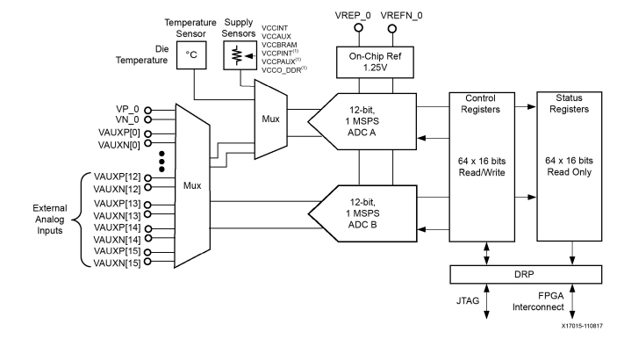
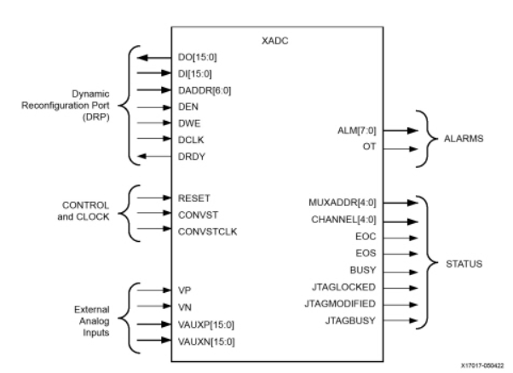
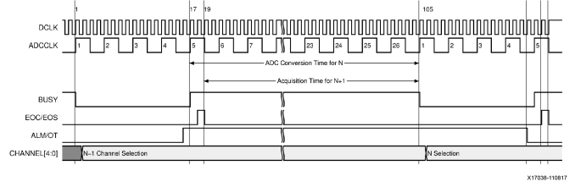
Further ADC Details
What are the peripheral components to the ADC?
Input mux
Status and control registers
Reference generator
Dynamic Reconfiguration Port (DRP) Interface
What parameters define how the ADC works?
Sample averaging
Unipolar or differential measurement mode
Settling time
Nexys A7 ADC Block Diagram
ADC Input/Output Signals
ADC Timing Diagram

Slide 6
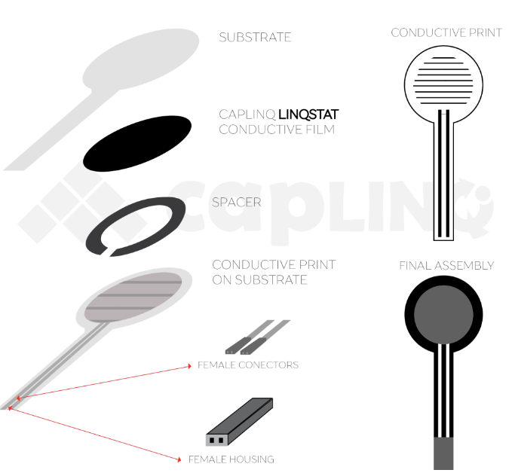
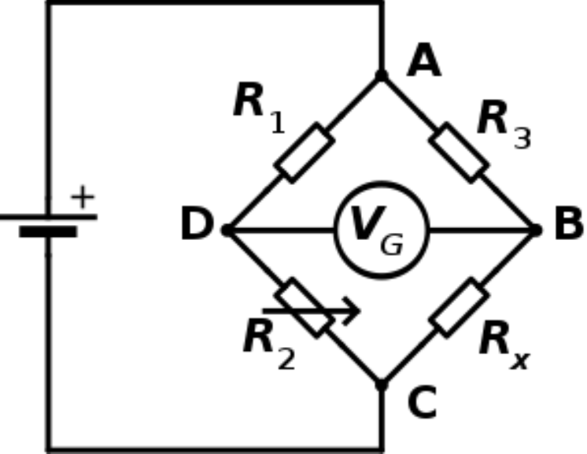
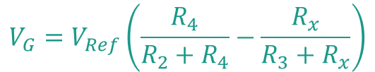
Force Sensitive Resistor (FSR)
FSR is an electrical component which changes its resistance when a force or pressure is applied.
Composed of two substrate layers sandwiching together a conductive film and a spacer.
The substrate layer on the spacer side also has a conductive ink printed on it.
More force => air pushed out of space => film contacts conductive print => resistance decreases
Problem: Not very differentiable (i.e., basically a 1 or 0)
Solution: Wheatstone Bridge
Breakdown of Force Sensitive Resistor
$$V_{G}=V_{Ref}\left(\frac{R_{4}}{R_{2}+R_{4}}−\frac{R_{x}}{R_{3}+R_{x}}\right)$$
Wheatstone Bridge with a variable resistor Rx

Slide 7
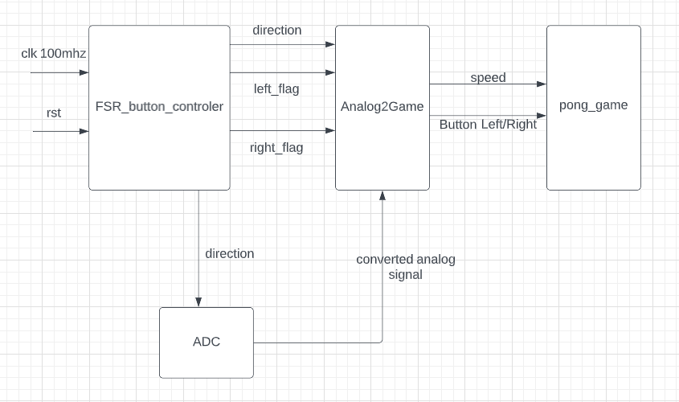
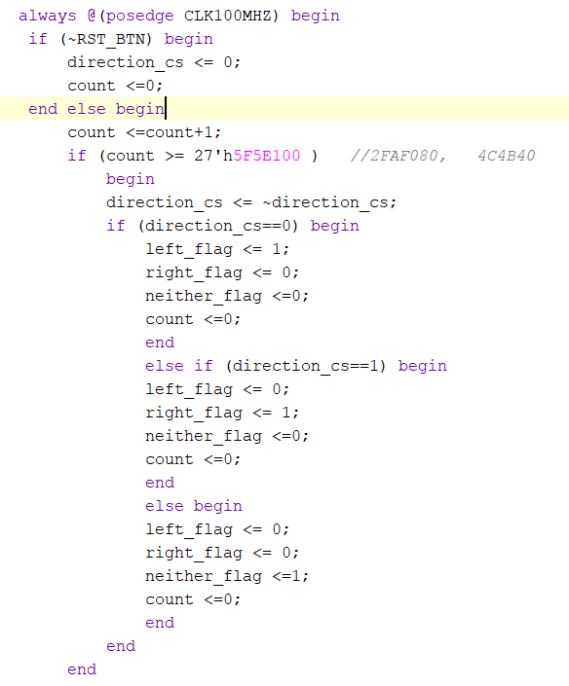
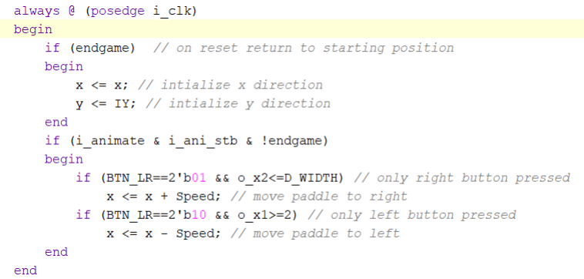
Pong Game
How did we change the game?
We need to pass the analog signal to the game.
Replaced the original input buttons with with the analog signal from the ADC.
Added replay button for capturing the last image before game over.
Capturing the end game signal to VGA.
Getting the speed signal from ADC to control the speed of paddle movement.
How do we use the output of the ADC
There is only one analog output each time. The signal is passed to the Analog2Game. Analog2Game will pass the direction to the game.

Slide 8
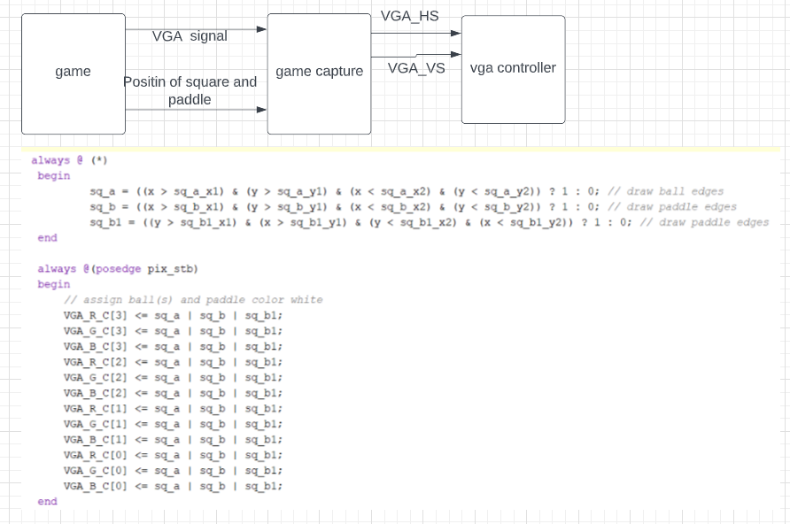
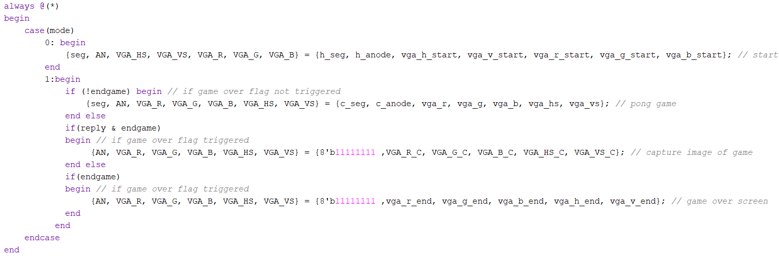
VGA Controller
We also need to replay the last frame of game
Capture the position of paddle and square, send it to the VGA
Using mode switch to show the image we capture from the game

Slide 9
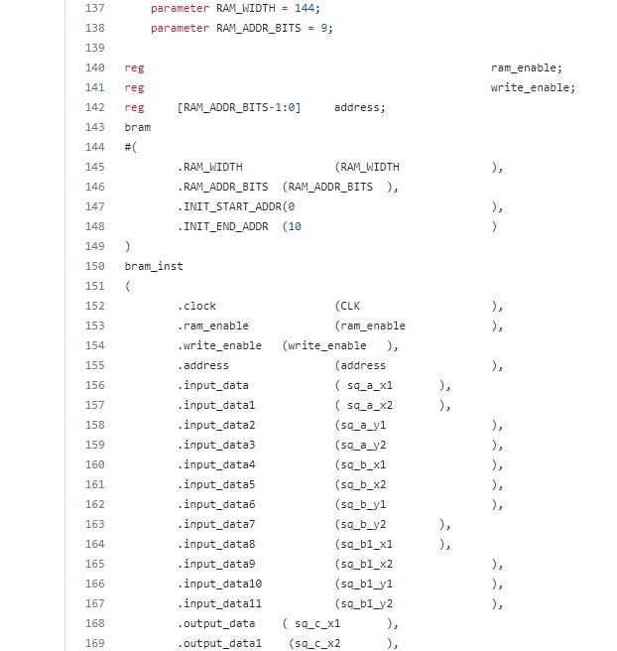
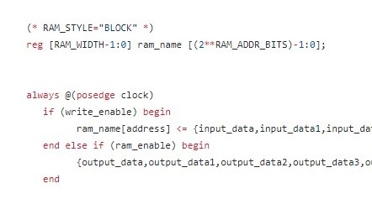
Memory
What were we planning on doing with the memory?
Record the process of playing and replay it after game over
Why didn’t it work?
Possible overwritten data
The delay of redrawing is overlapped by next redrawing
How does Quad SPI flash work?
Not suitable for saving data
What did we end up doing instead?
Saving images of game process such as when square hits the edge

Slide 10
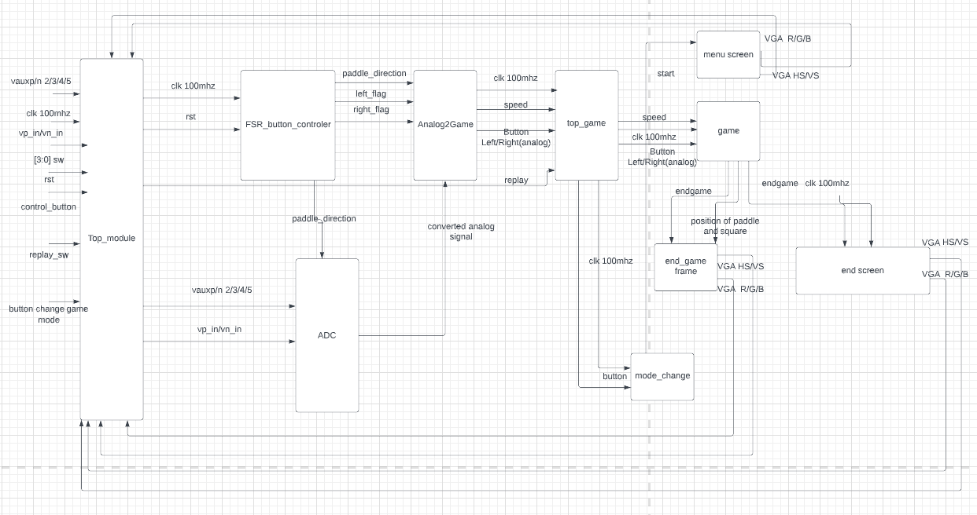
Block Diagram

Slide 11
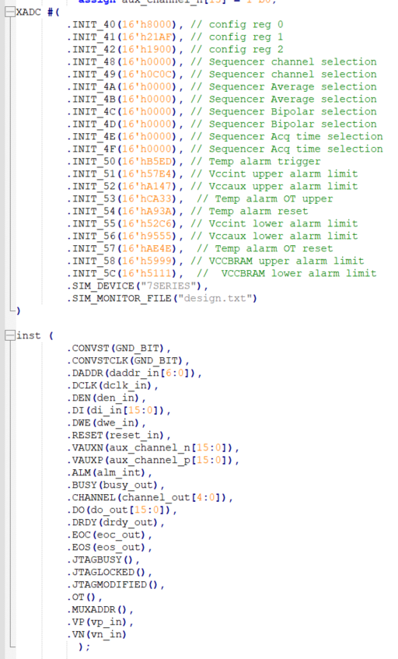
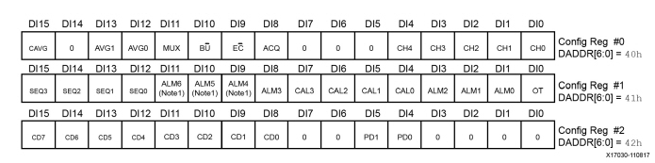
Verilog Example
ADC instantiation
Initializing the control registers to define the ADC operation after configuration
Connect ADC I/Os to the design
DRP is the interface between the ADC and FPGA through which the FPGA can access the ADC registers

Slide 12
Successes
Got the game to work [Bin]
Ball movement, start and end game display
Demonstrated analog nature of input sensor [Conor]
Pressing harder makes it move faster
Achieved using Wheatstone bridge setup
Multi-Channel ADC sampling [Conor]
Replaying final frame from game [Bin/Yimin]

Slide 13
Failures
Use of Quad SPI flash memory
Original plan was to demonstrate NVRAM
Unable to figure out SPI protocol to interact with Quad SPI flash
ADC timing issue
Despite flags, still had some issues with output from button press being applied to opposite

Slide 14
GitHub Link
https://github.com/xu842251462/EC551_Final_Project

Slide 15
References
https://github.com/Digilent/Nexys-A7-100T-XADC
https://github.com/chmo2019/EC311_Final_Project
https://www.chipverify.com/verilog/verilog-single-port-ram

